Slide 1


//Developers_Institute_
TLV Coding Bootcamp
"Time Series Analysis of Pittsburgh Temperature, Energy Consumption, and Flu Contagion"
Developers Institute ranked for Best Coding Bootcamp Worldwide for 2023
Azerbaijan 🇦🇿- México 🇲🇽 - Cameroon 🇨🇲 - Senegal 🇸🇳 - Burkina Faso 🇧🇫 - Mali 🇲🇱 - Ghana 🇬🇭 - Togo 🇹🇬 - Mauritius 🇲🇺 - Morocco 🇲🇦 - India 🇮🇳 - Georgia 🇬🇪 - Israël 🇮🇱

Slide 2
Time Series Analysis of Pittsburgh Temperature, Energy Consumption, and Flu Contagion
Problem Solved: Provides a Predictive Modeling Approach to Understanding Interconnected Urban Systems.
This project addresses the critical need to understand and forecast complex urban system interactions by conducting a comprehensive time series analysis that integrates three key datasets: temperature, electrical demand, and influenza-like illness (ILI) activity levels in Pittsburgh.
Forecasting Techniques: ARIMA and XGBoost for temperature prediction, XGBoost for modeling temperature-dependent electrical demand and flu activity.

Slide 3
Stack
Programming Languages: Python 3.x.
Data Manipulation & Analysis: Pandas, NumPy, SciPy.
Time Series Analysis Libraries: Statsmodels, MSTL, Scikit-learn.
Machine Learning Libraries: XGBoost, ARIMA.
Visualization: Matplotlib, Seaborn, Tableau.
Specific Techniques Used: time series decomposition, moving average, seasonal decomposition, machine learning forecasting, statistical forecasting.
Development Environment: Jupyter Notebook, VS Code.
Version Control: GitHub.

Slide 4
Feature list
Window features, time-based features, seasonal decomposition, temperature correlation, moving average, MSTL decomposition, XGBoost predictors, ARIMA parameters, and cross-seasonal analysis were the key features engineered in this time series project to capture complex temporal dependencies and enhance forecasting accuracy.

Slide 5
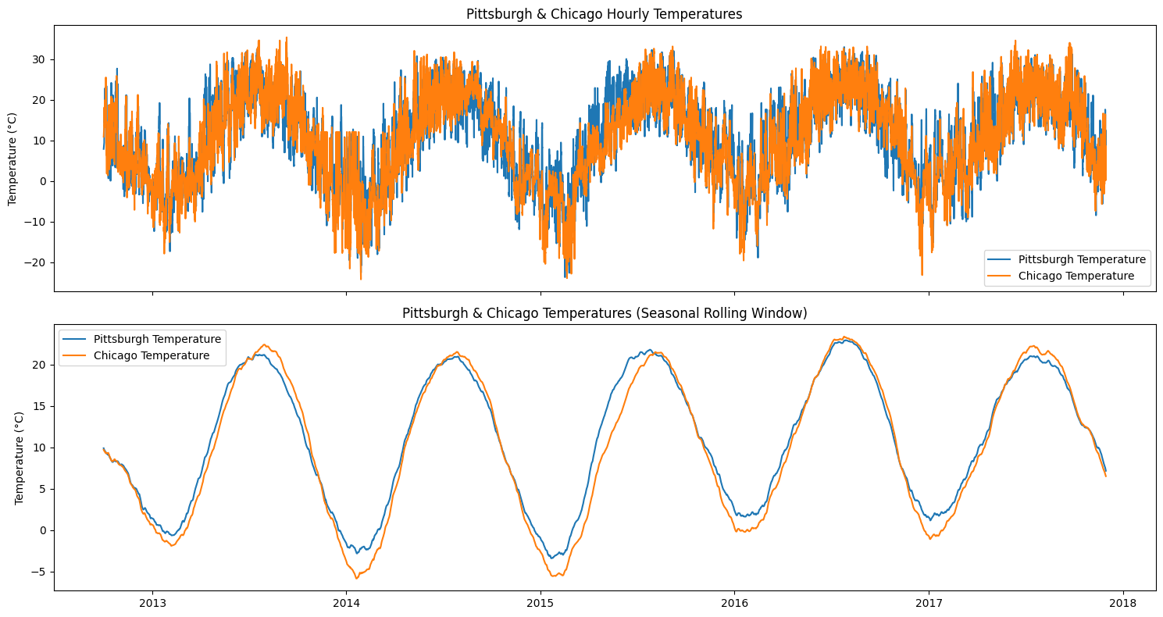
Comparative Seasonal Analysis: TS decomposition

Slide 6
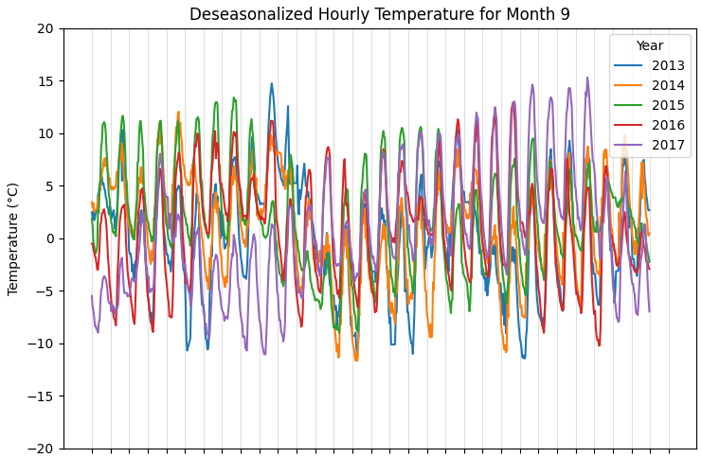
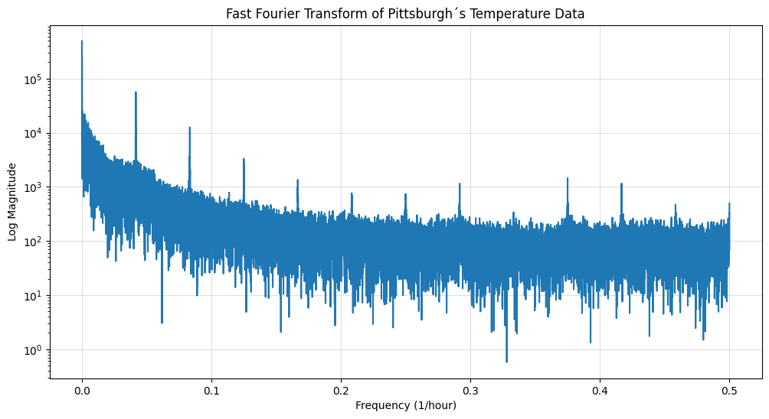
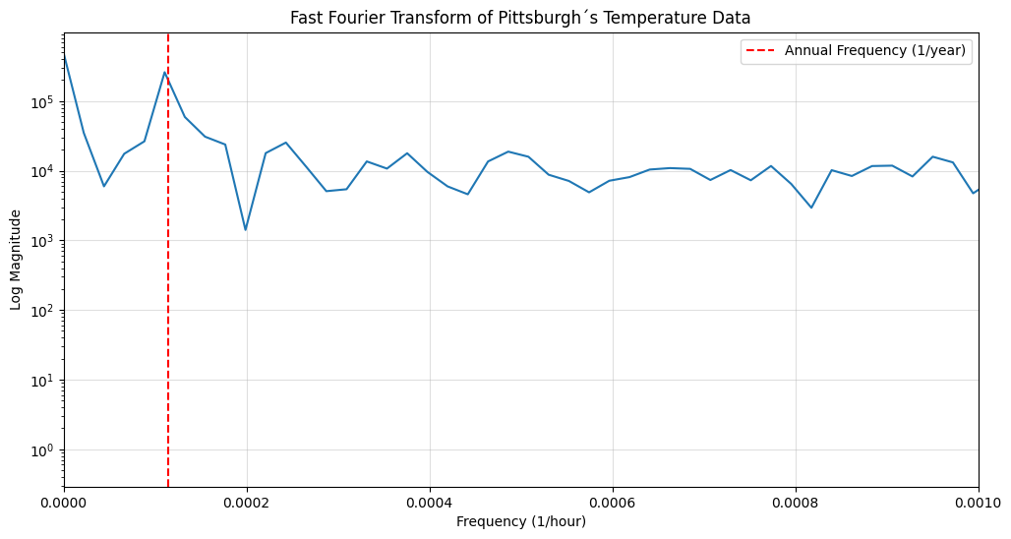
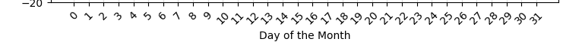
Spectral Insights: High-Frequency and FFT

Slide 7
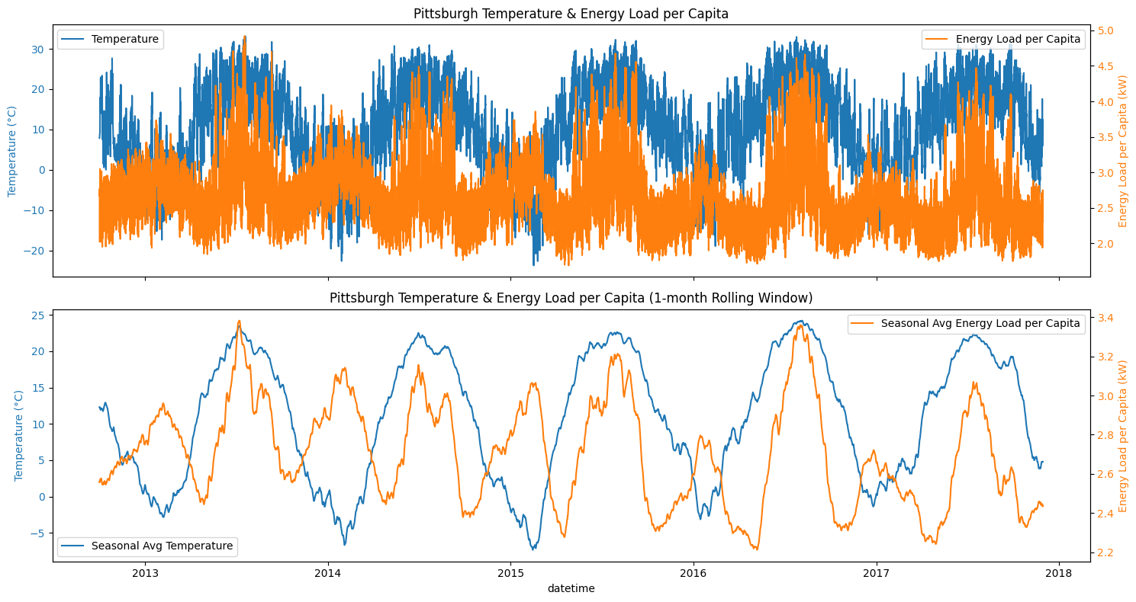
Multiseasonal Dynamics and Correlation Patterns
Notes:
Electricity demand is highly correlated with temperature, with a U-shaped relationship where consumption varies based on heating and cooling needs. But also is correlated with human activity patterns: day of week, hour of day, holiday…

Slide 8
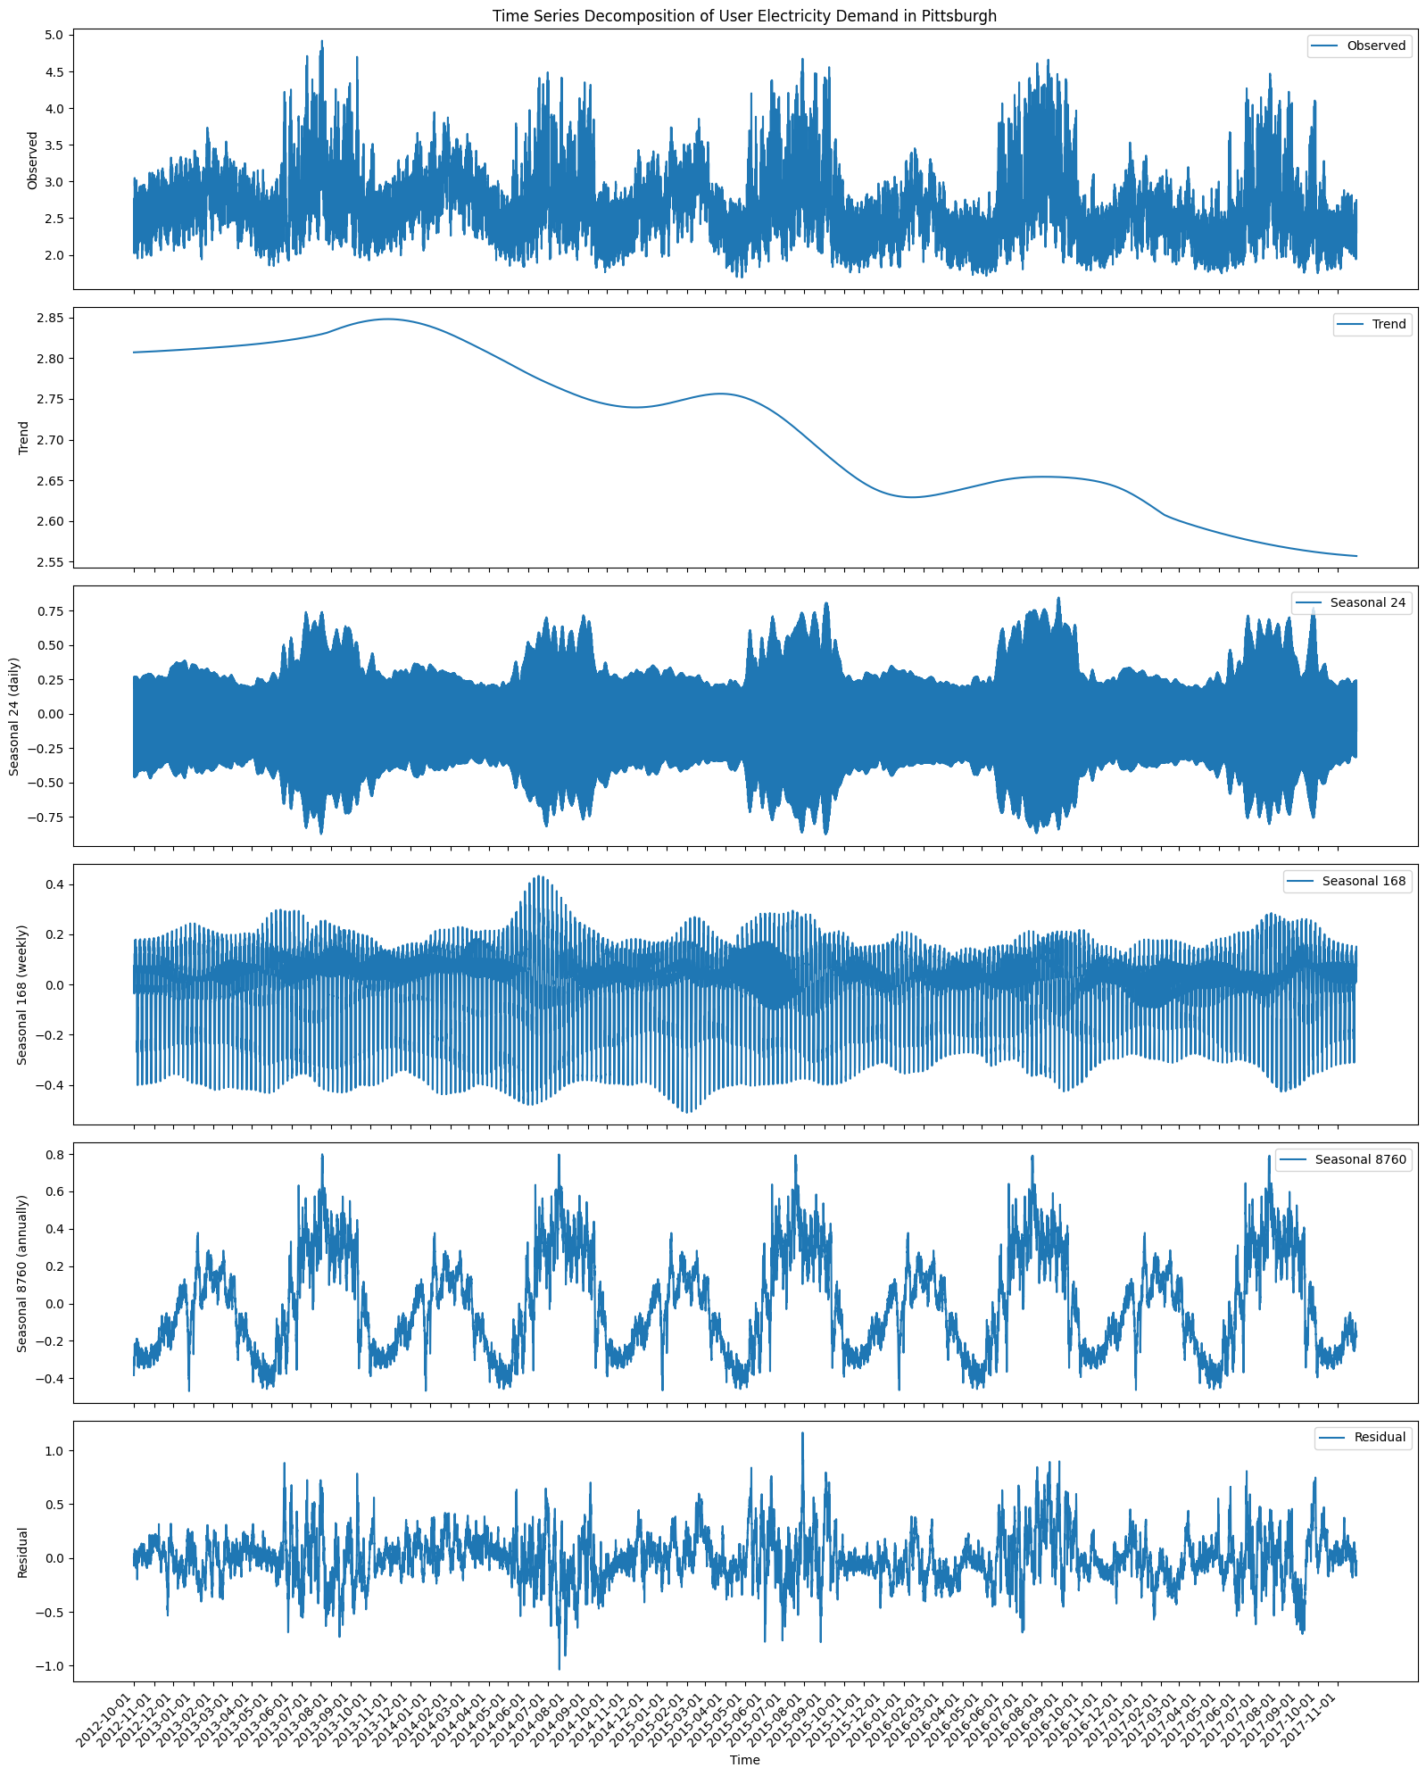
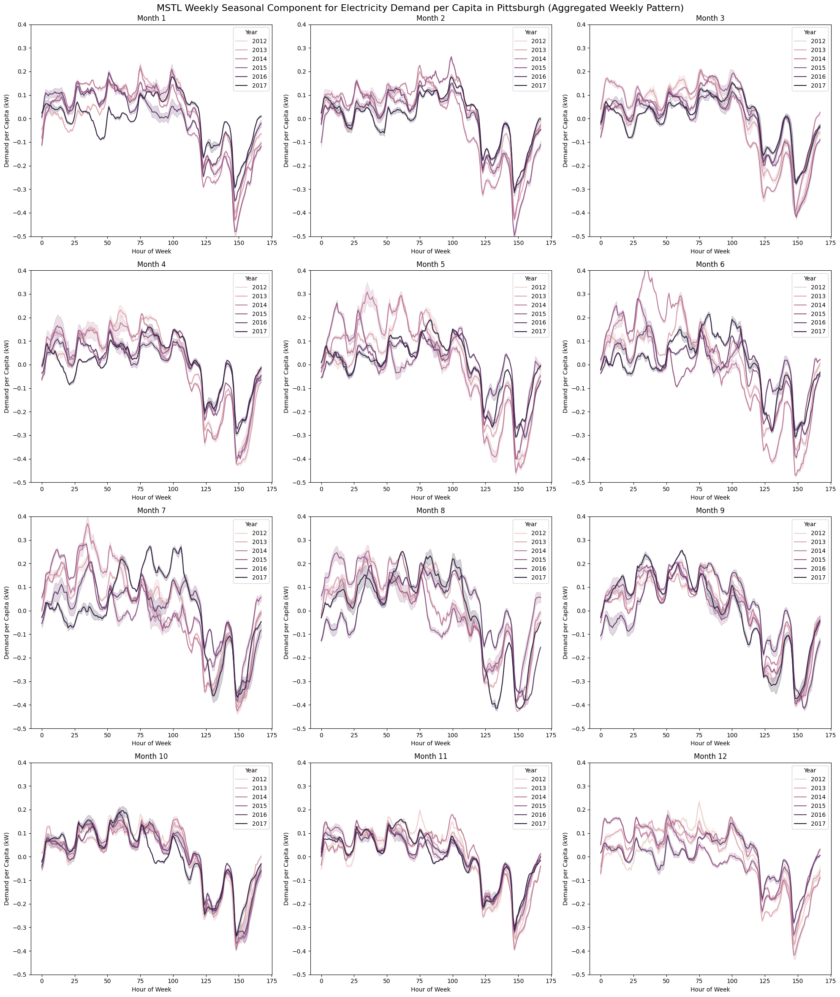
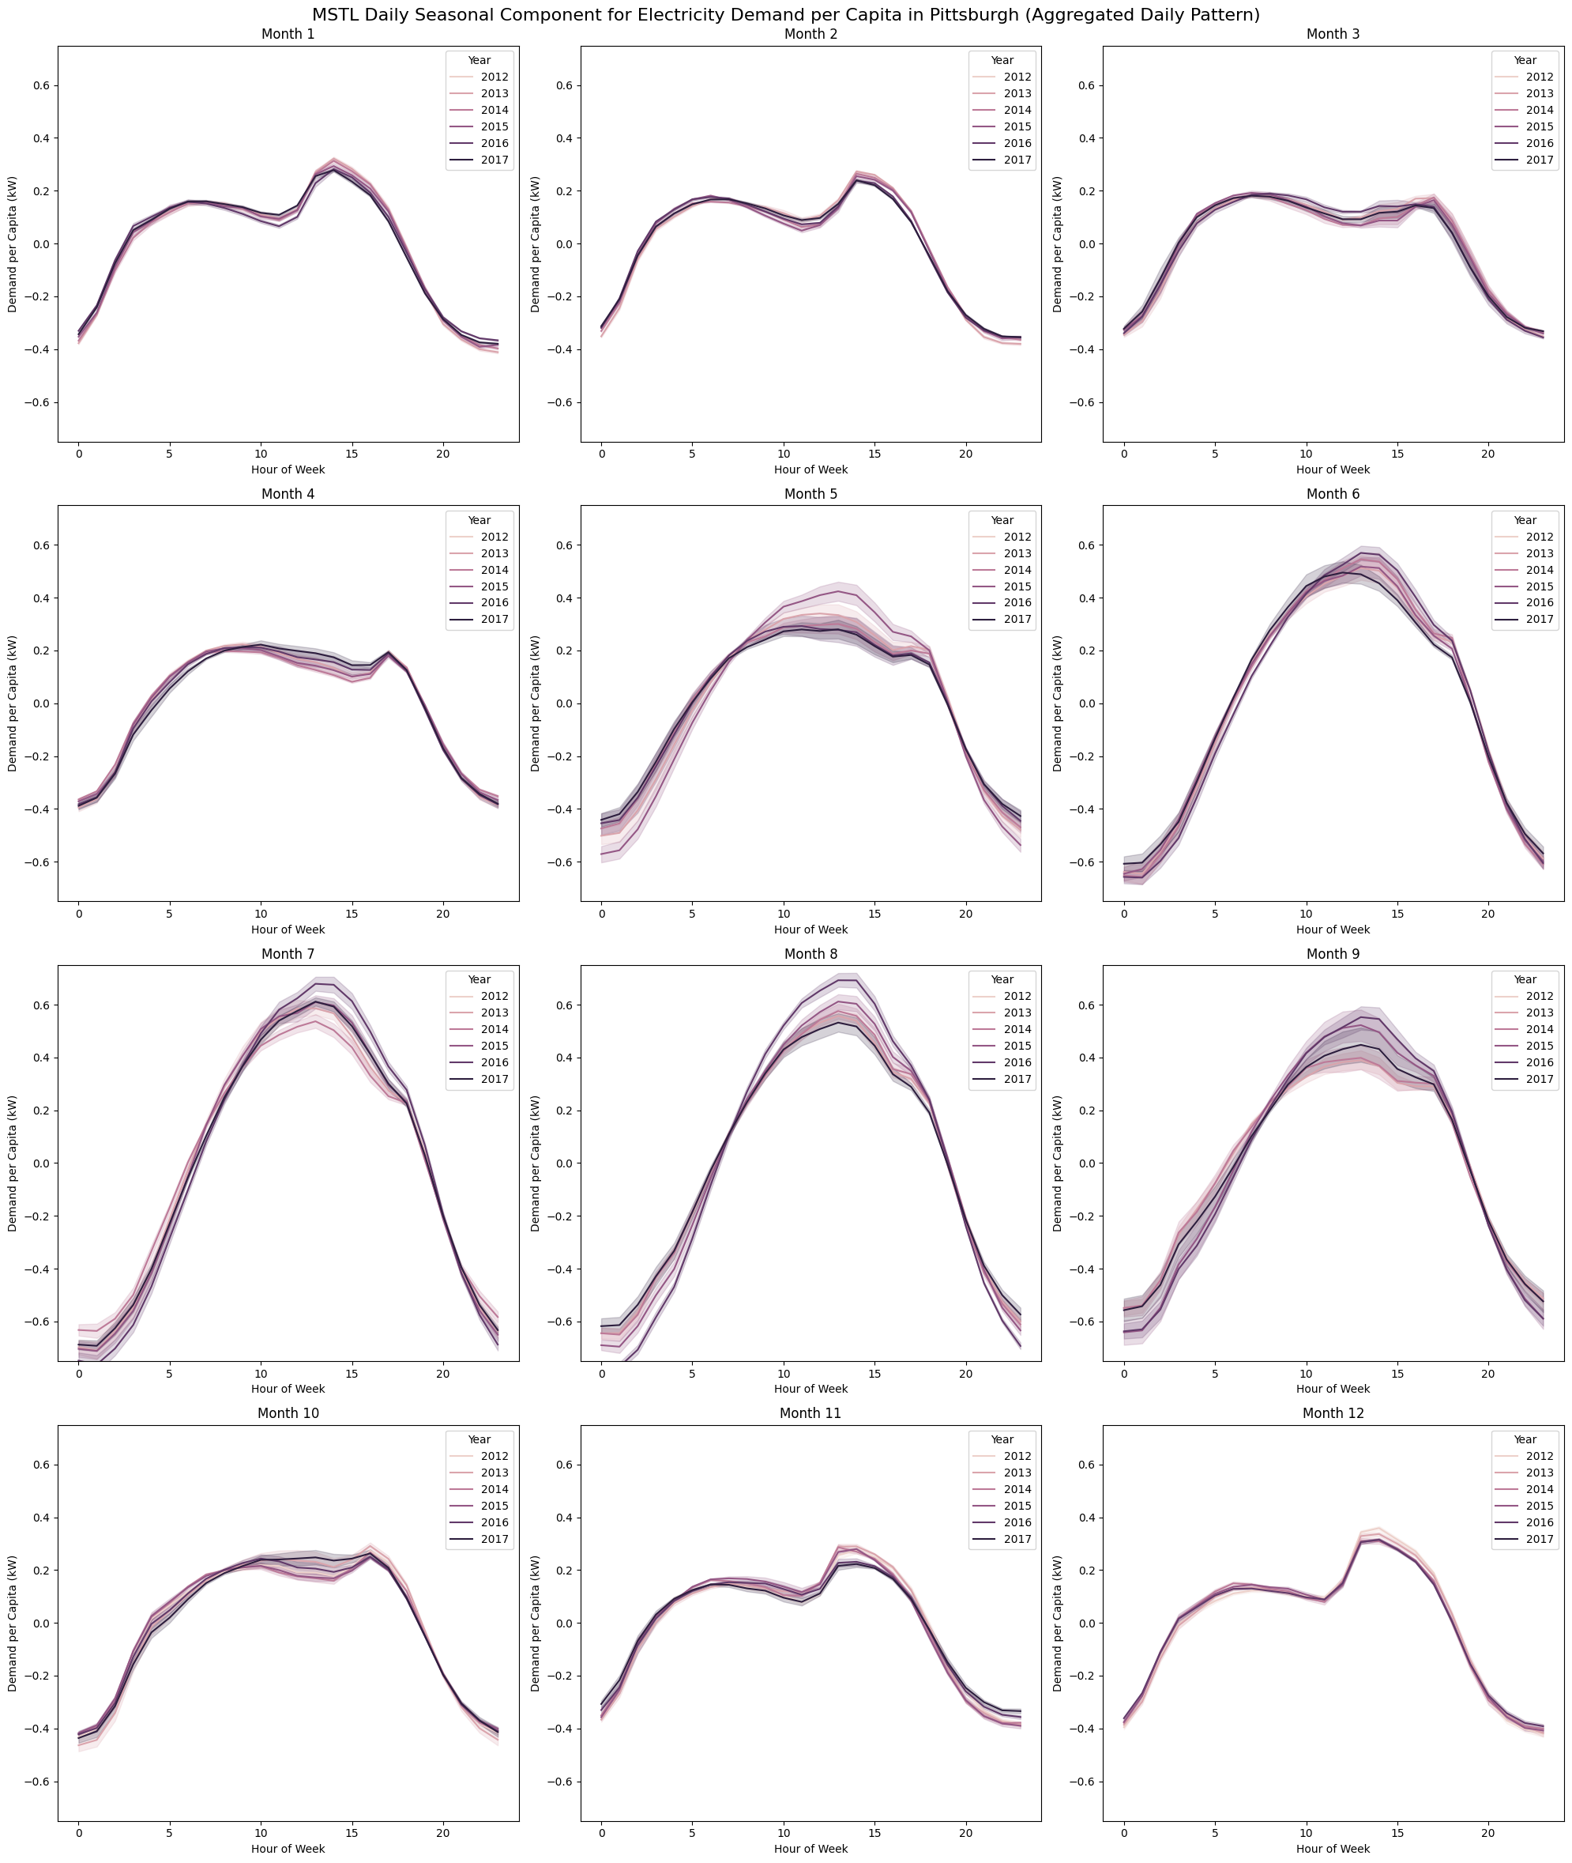

Multiple Seasonal-Trend decomposition using LOESS
Notes:
NOMBRAR QUE EL TREND TIENDE A LA BAJA!!!!!!!!!!!!!

Slide 9
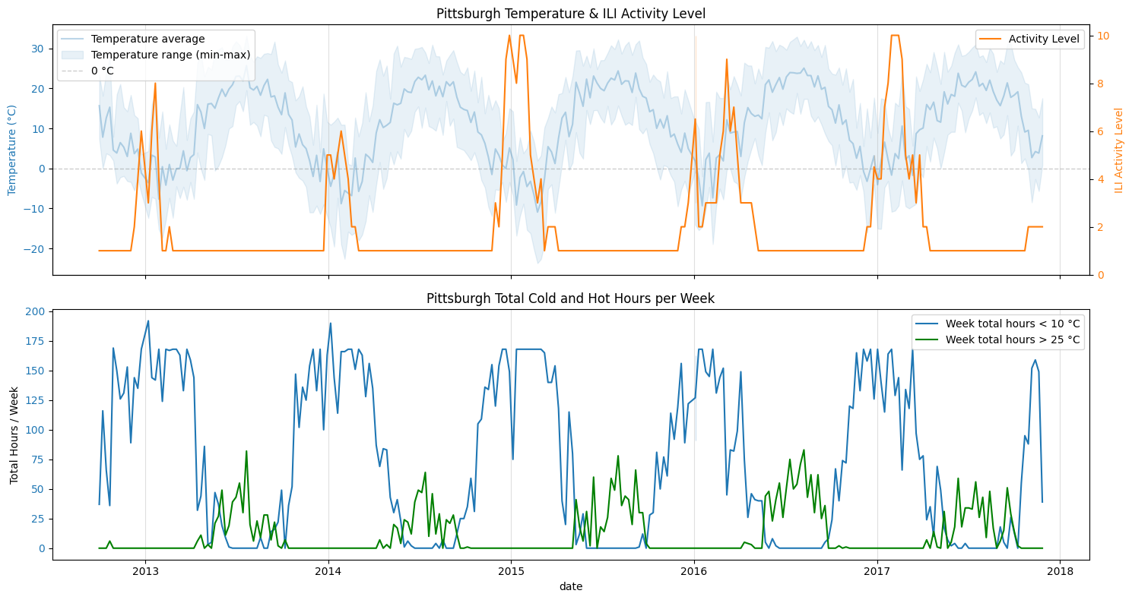
Seasonal Dynamics and Correlation Patterns

Slide 10
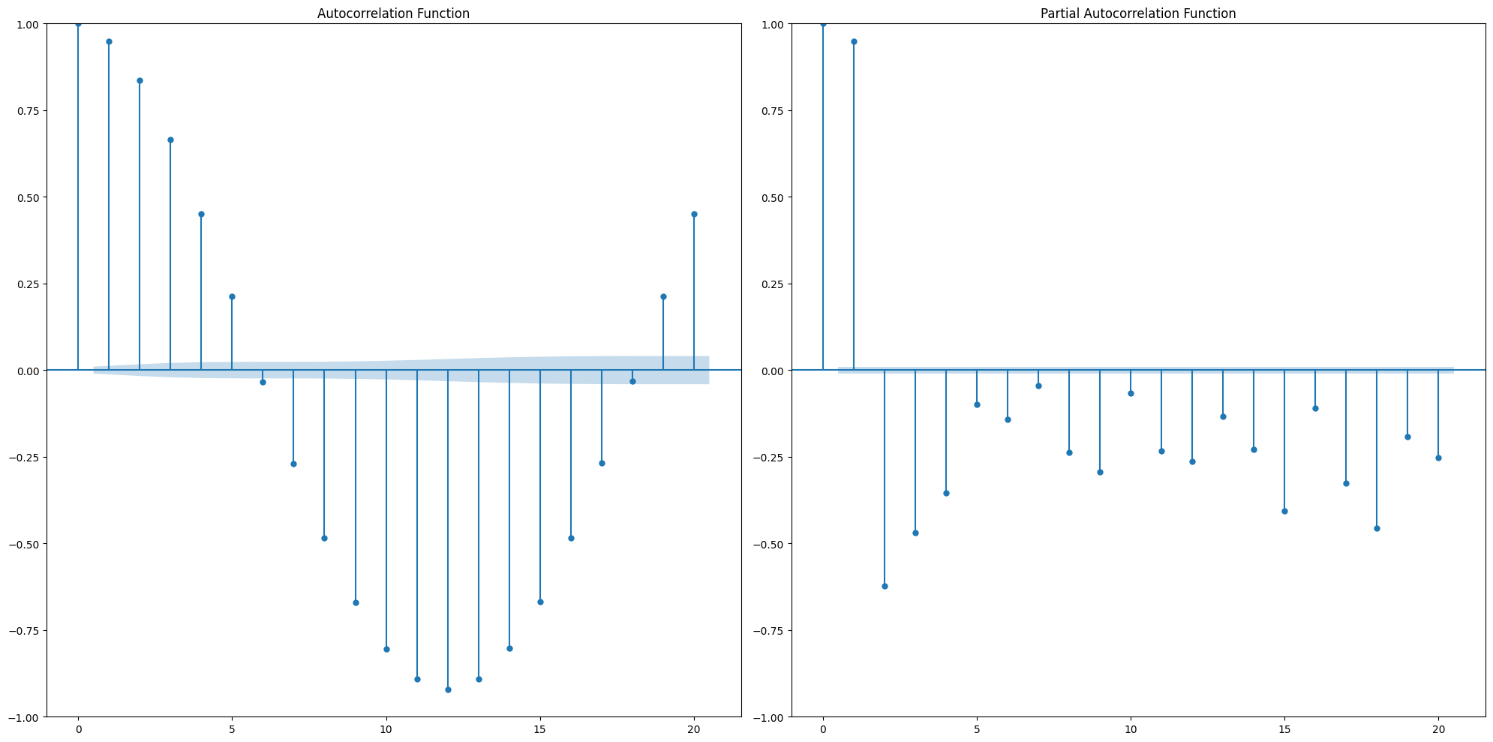
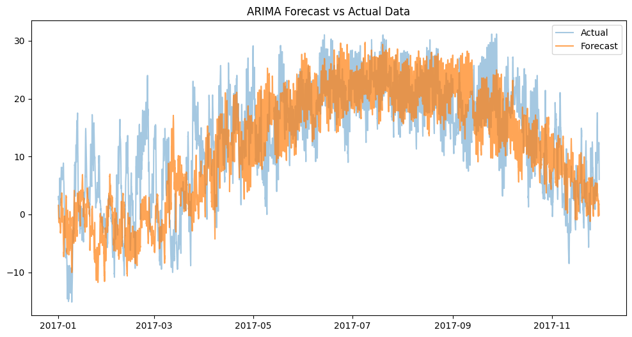
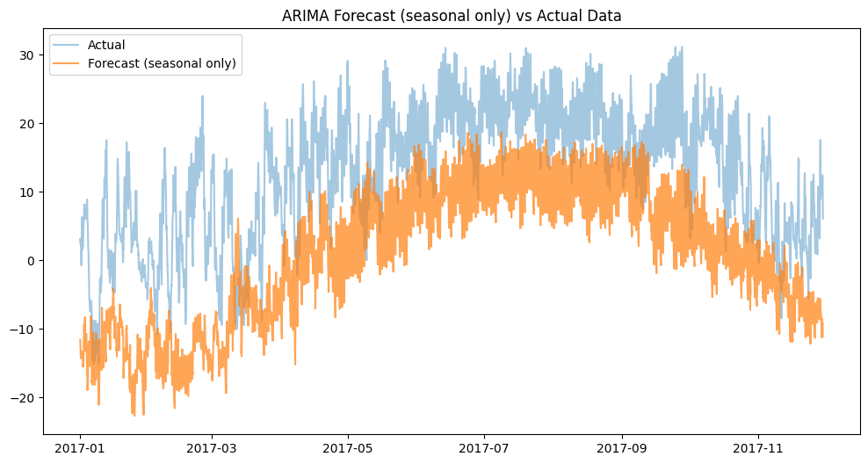
Auto-Regressive Integrated Moving Average Forecast
MAE: 5.1884
MSE: 44.1332
RMSE: 6.6433
Notes:
ARIMA stands for Auto-Regressive Integrated Moving Average, a powerful statistical technique for time series forecasting. It comprises three key components:
Autoregressive (AR): Uses correlation between current and past observations
Integrated (I): Involves differencing to make the time series stationary
MA (Moving Average): Accounts for the relationship between current observation and past residual errors

Slide 11
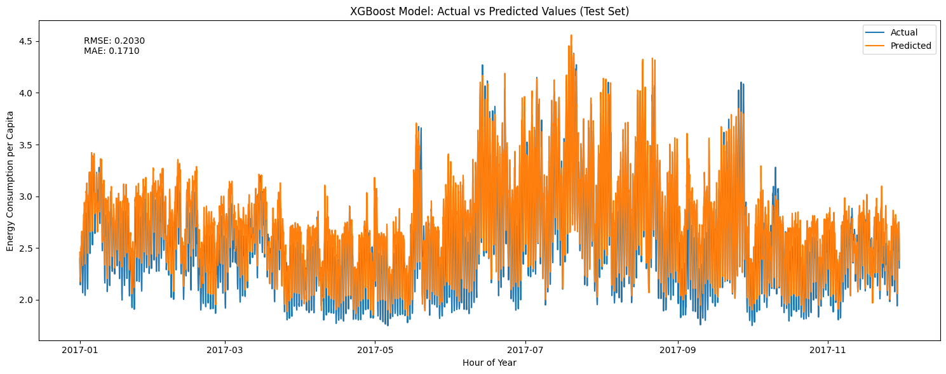
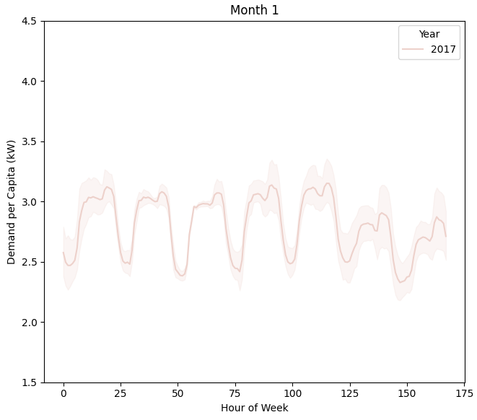
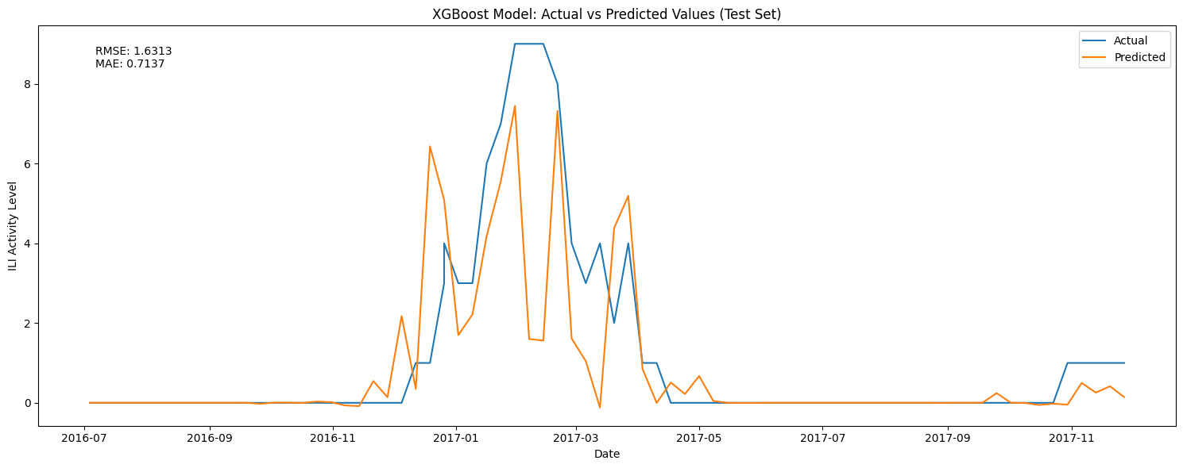
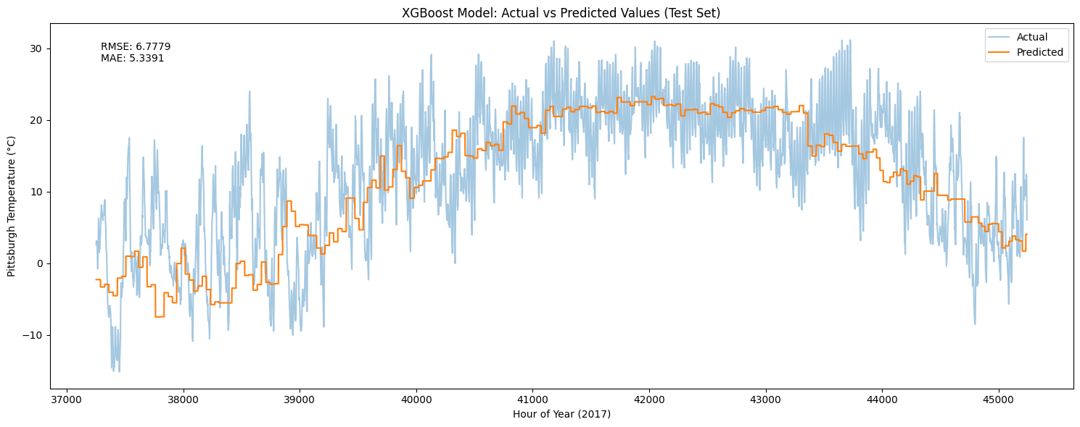
ML: Extreme Gradient Boosting Forecasts
## Feature Importance:
- hour of day : 0.43
- temperature: 0.33
- day of week: 0.12
- hour of year: 0.06
- is holiday: 0.05
## Feature Importance:
- week: 0.53
- temp_mean: 0.15
- temp_max: 0.15
- temp_min: 0.09
- cold_hours: 0.04
- hot_hours: 0.05

Slide 12
Conclusions
Seasonal Decomposition: Powerful technique for revealing hidden cyclical patterns and anomalies, with MSTL demonstrating exceptional capability in handling complex multi-seasonal time series
ARIMA Modeling: Highly sensitive method requiring meticulous parameter tuning, with significant limitations in multi-seasonal forecasting scenarios
XGBoost Performance: Robust machine learning algorithm excelling in diverse forecasting challenges, demonstrating remarkable resilience to scale, outliers, and variable interactions
Core Takeaway: Time series analysis can capture intricate temporal dynamics across multiple domains.

Slide 13
Link
Github
2-mn video
Portfolio

Slide 14
Career Prep
CV
Linkedin
Job tracker link

Slide 15
Future Steps
Multi-Seasonal Models: Explore TBATS and MSTL for handling other complex seasonal patterns
Urban Transportation Demand: Carpooling and public transit usage prediction based on weather seasonal variations
Public Health Forecasting: Illness outbreak prediction correlating weather seasonal patterns
Technical Enhancements: Develop more complex feature engineering techniques

Slide 16
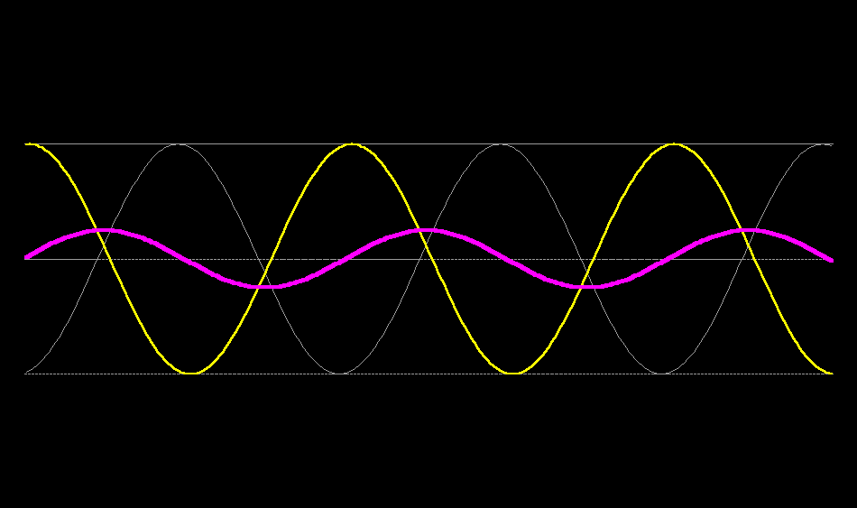
Image credit: https://trampleasure.net/science/physics/waves/standing_wave.php

